Slide 1
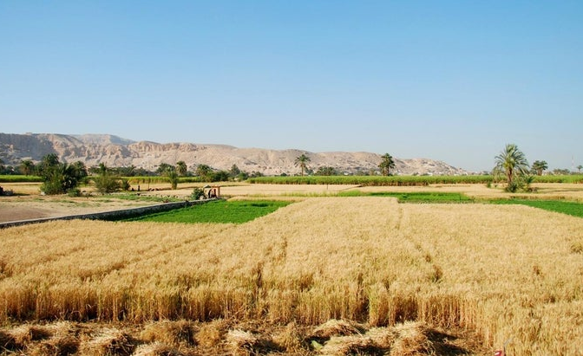
Benchmarking yield gaps and resource use efficiency with data analytics and crop modelling
Yield gap analysis for irrigated wheat in Egypt
João Vasco Silva, Antoine Languillaume, Chandrashekhar Biradar, Atef Swelam, Vinay Sangia, Martin van Ittersum
Notes:
Date and activity

Slide 2
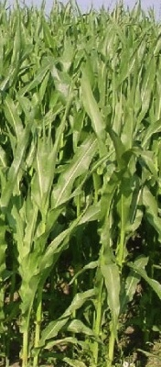
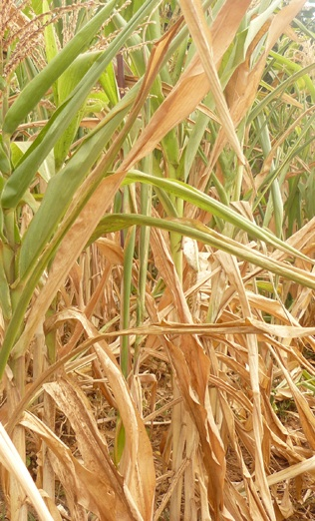
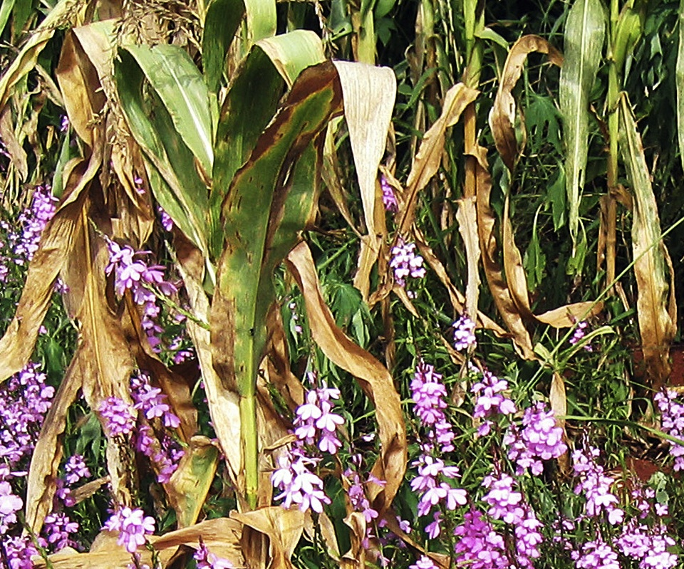
Concepts for yield gap analysis
Defining factors
CO₂
radiation
temperature
crop genetics
Limiting factors
water
nutrients
(N,P,K)
Reducing factors
weeds
pests
diseases
pollutants
Yield level
yield gap
Potential
Yield (Yp)
Limited
Yield (Yw)
Actual
yield (Ya)
van Ittersum & Rabbinge (1997, FCR)

Slide 3
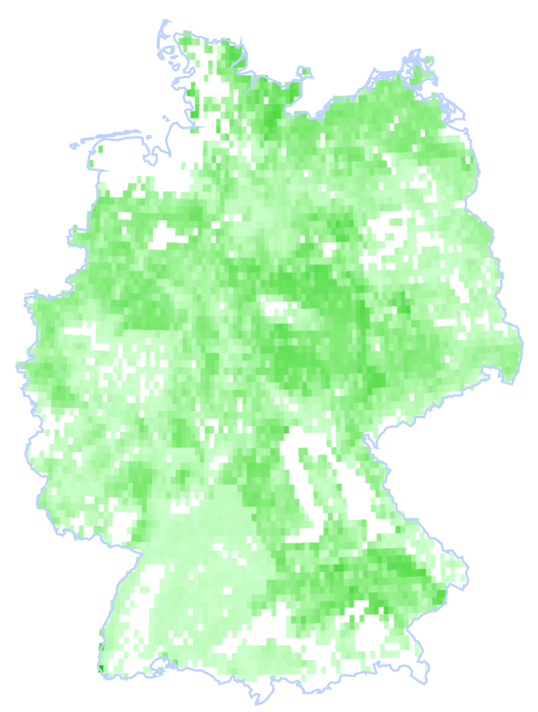
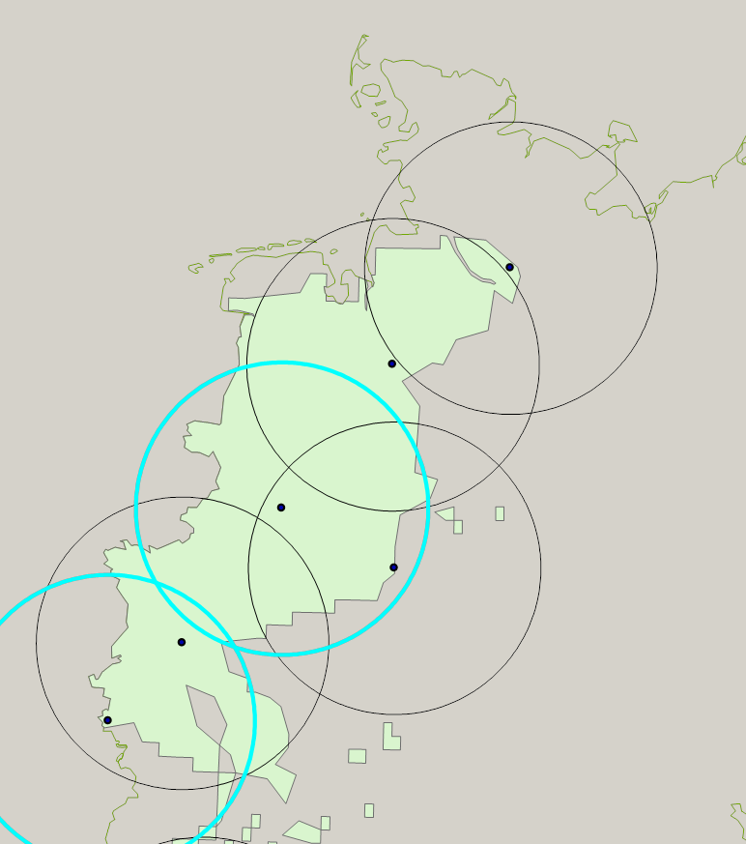
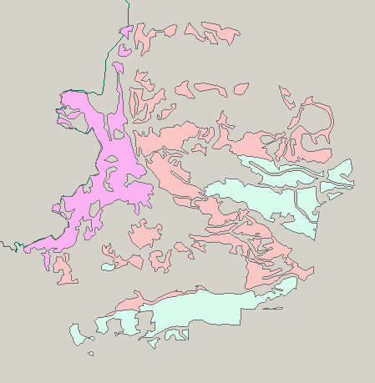
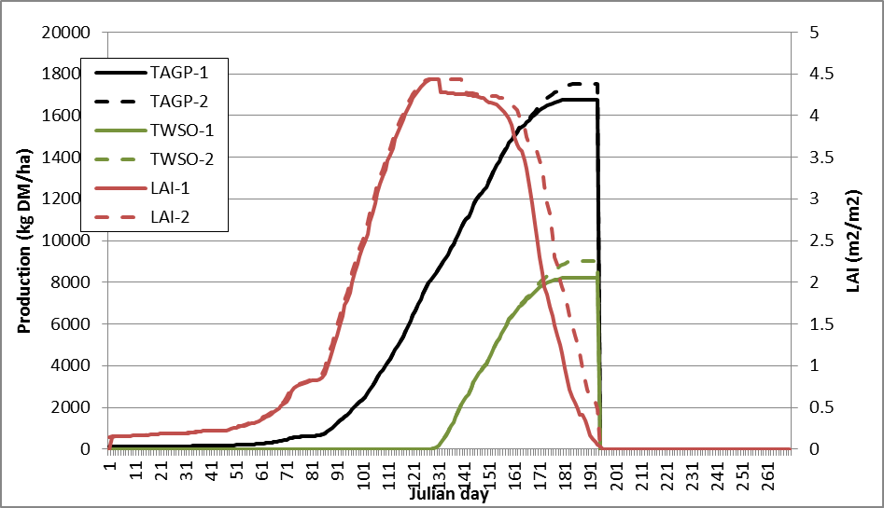
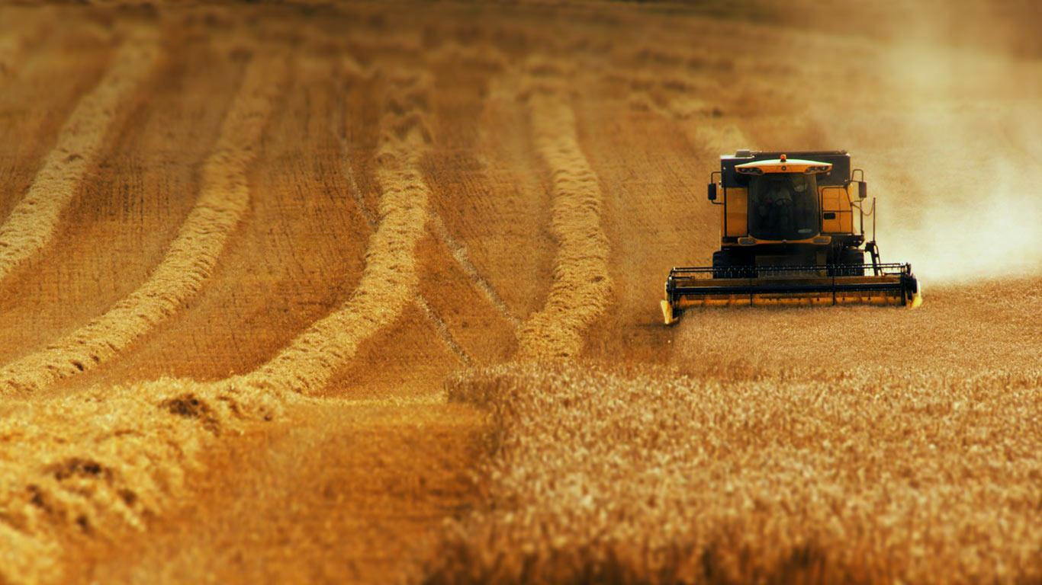
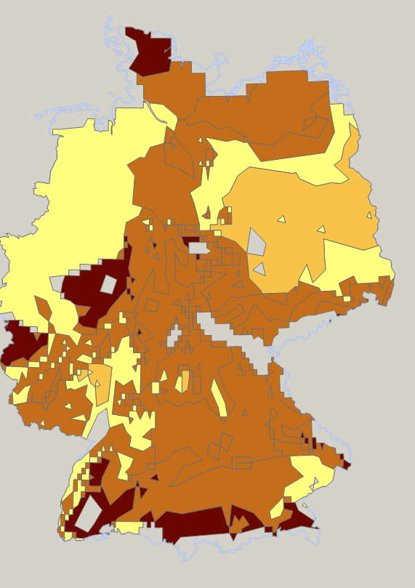
Protocol Global Yield Gap Atlas
Crop-specific harvested areas
Weather station buffer zones
Soil types and cropping systems
Crop model simulations
Actual yields
Yield gaps
www.yieldgap.org

Slide 4
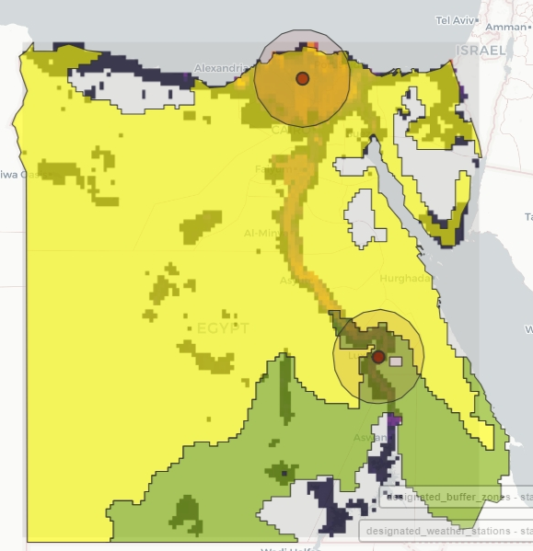
Climate zone selection and weather stations
Wheat production along the Nile valley and in the Nile delta
Most country covered by one climate zone one, except southern part
2 buffer zones centered by weather stations in Kafr-El-Sheikh and Luxor
Each buffer zone covers >50% of the wheat area in each climate zone

Slide 5
Cropping system characteristics – Nile delta
station_name | Sakha | Nile Delta
cropping_system | Mainly field crops with about 10-15% orchards | There is mix with vegetables
per_rainfed | (20% in north Nile delta to 0% south delta) | the maximum rainfall in north delta is 80 mm/year (winter)
per_irrigated | almost 100% (5 irrigation events)
irrigation_type | flood irrigation
main_soil_type | clay soil (with clay content 39-42%)
per_main_soil_type | 100%
main_crop_rotation | Wheat-Sugarbeet-Barseem/Maize-Rice-Cotton | There is no followed crop rotation or system, but these are the most common crops
sowing_window_start | October, 25
sowing_window_end | December, 15
harvest_period_start | April, 15
harvest_period_end | May, 15
main_cultivar | Giza 171
ndays_emergence_flowering | 90-105
ndays_flowering_maturity | 40-60
harvest_index | 0.33-0.38
November 15
ca. 165 days
May 1
ca. 150 days

Slide 6
Cropping system characteristics – Upper Egypt
station_name | Luxor | Upper Egypt
cropping_system | Field crops and about 20% sugarcan | There is mix with vegetables
per_rainfed | 0% | There is no rainfall in upper Egypt
per_irrigated | 100% (7 irrigation events)
irrigation_type | flood irrigation/sprinkler
main_soil_type | clay soil, loamy soil, sandy soil
per_main_soil_type | 60%, 25%, 15%
main_crop_rotation | Wheat-Barseem/Sugar cane-Maiz-Sorgum | There is no followed crop rotation or system, but these are the most common crops
sowing_window_start | November, 15
sowing_window_end | December, 15
harvest_period_start | April, 20
harvest_period_end | May, 15
main_cultivar | Giza 168
ndays_emergence_flowering | 80-90
ndays_flowering_maturity | 35-50
harvest_index | 0.29-0.38
November 15
ca. 165 days
May 1
ca. 130 days

Slide 7
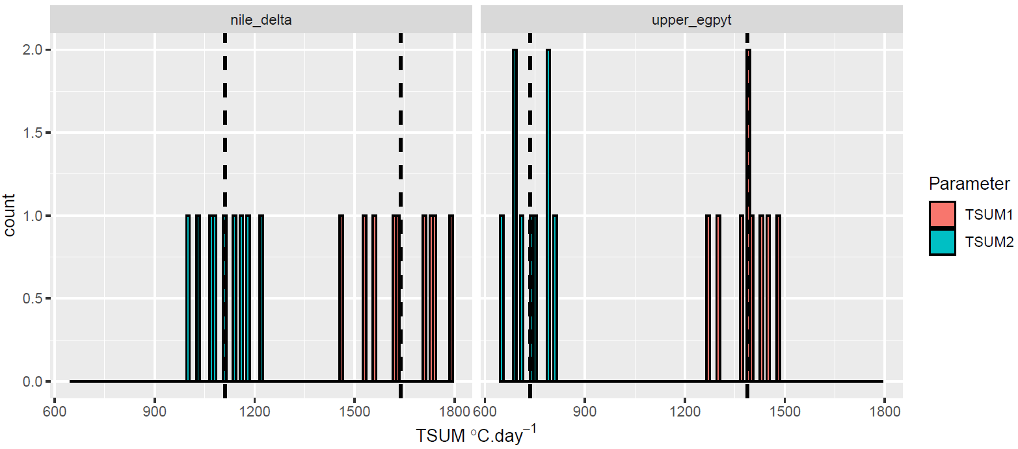
Calibrated crop parameters
1111
1639
735
1387
Other parameters:
SLATB = 0.0037 ha/kg -- specific leaf area as a function of DVS
SPAN = 35 days -- life span of leaves growing at 35 Celsius
AMAXTB = 45; 7.5 kg/ha/hr -- max. CO2 assimilation rate as a function of DVS

Slide 8
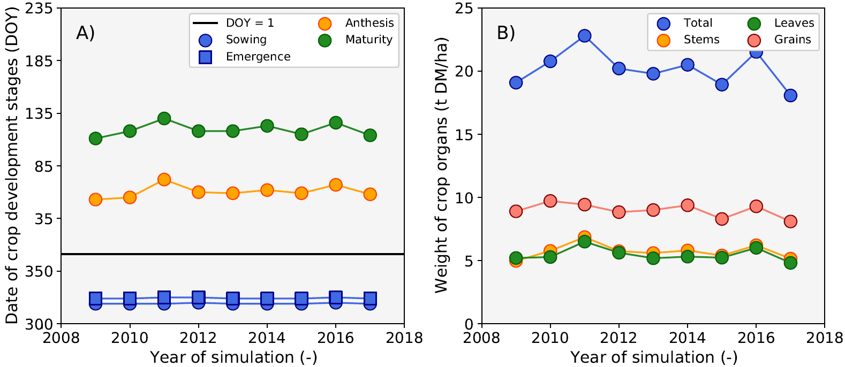
Simulated Yp – Nile delta
Mean = 120 DOY; April 30
Mean = 9.0 t DM ha⁻¹
Mean = 60 DOY; March 1
Mean = 324 DOY; November 20
Maturity – Emergence = 161 days

Slide 9
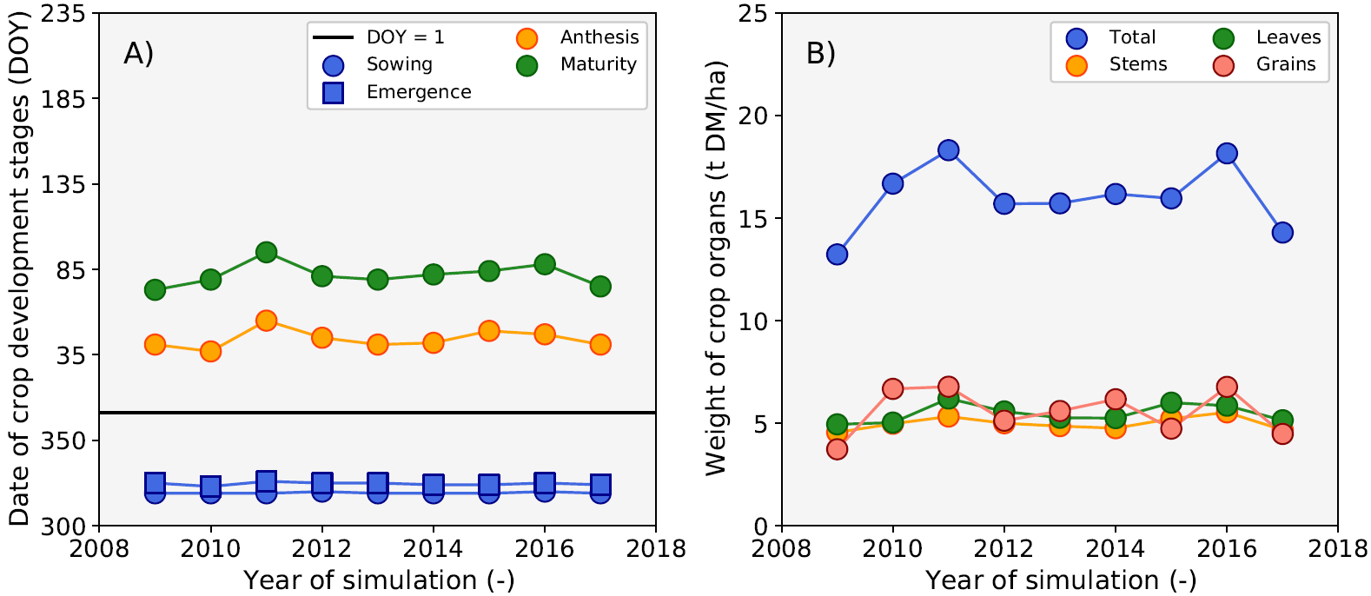
Simulated Yp – Upper Egypt
Mean = 82 DOY; March 23
Mean = 5.6 t DM ha⁻¹
Mean = 44 DOY; February 13
Mean = 324 DOY; November 20
Maturity – Emergence = 123 days

Slide 10
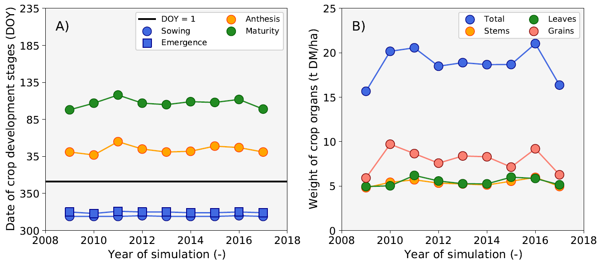

Simulated Yp – Upper Egypt – TSUM2+600
Mean = 105 DOY; March 23
Mean = 7.9 t DM ha⁻¹
Mean = 44 DOY; February 13
Mean = 324 DOY; November 20
Maturity – Emergence = 146 days

Slide 11
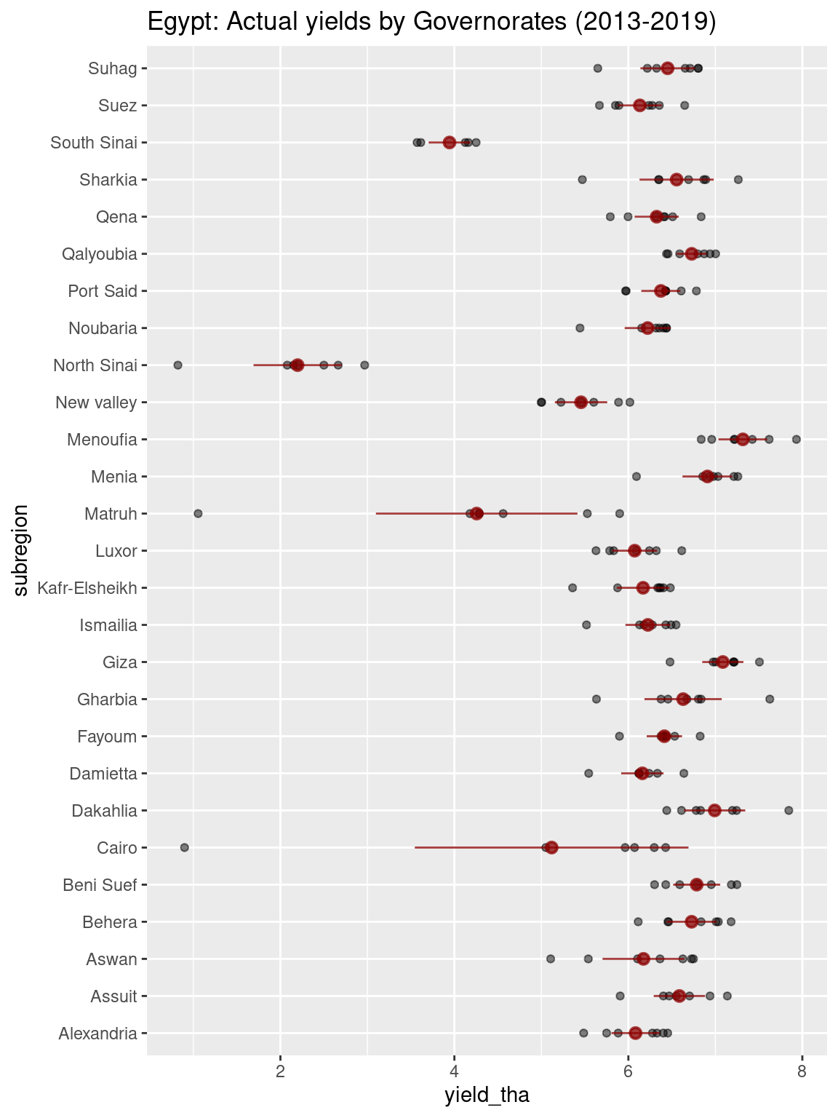
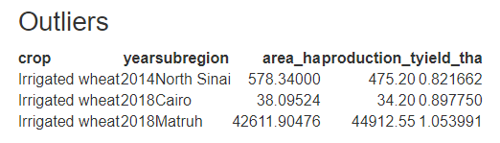
Actual yields at governorate level

Slide 12
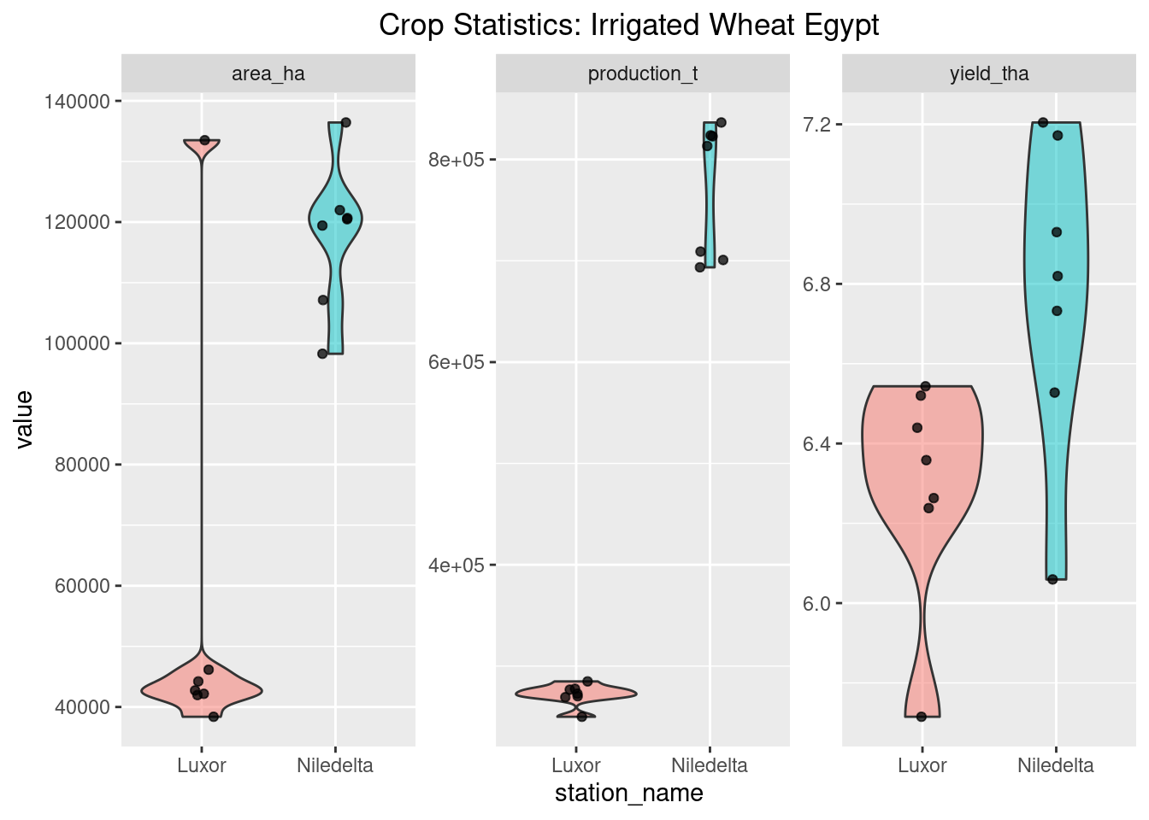
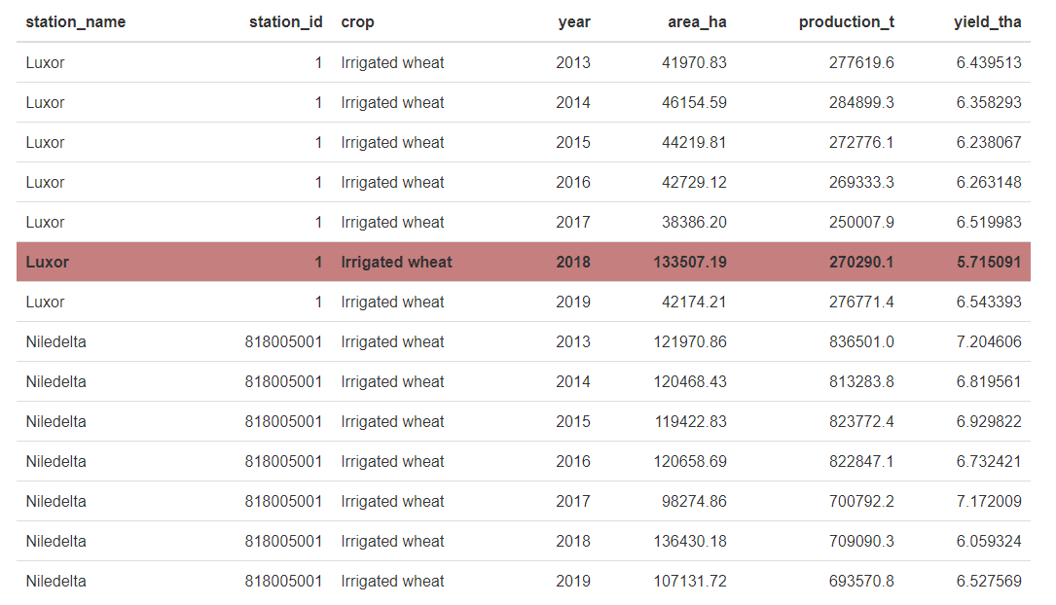
Actual yields at buffer zone level

Slide 13
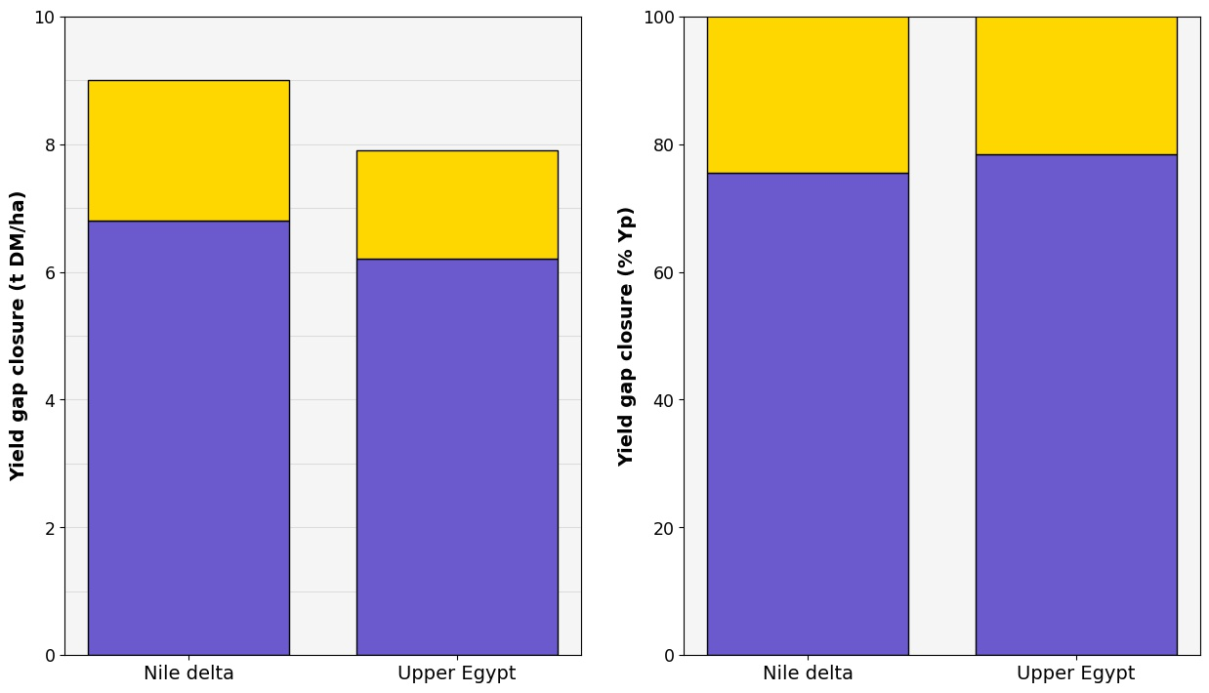
Yield gap closure for wheat in Egypt
9.0 t/ha
7.9 t/ha
75% of Yp
78% of Yp
6.8 t/ha
6.2 t/ha

